Slide 1
Lesson 8
Communication Subsystem

Slide 2
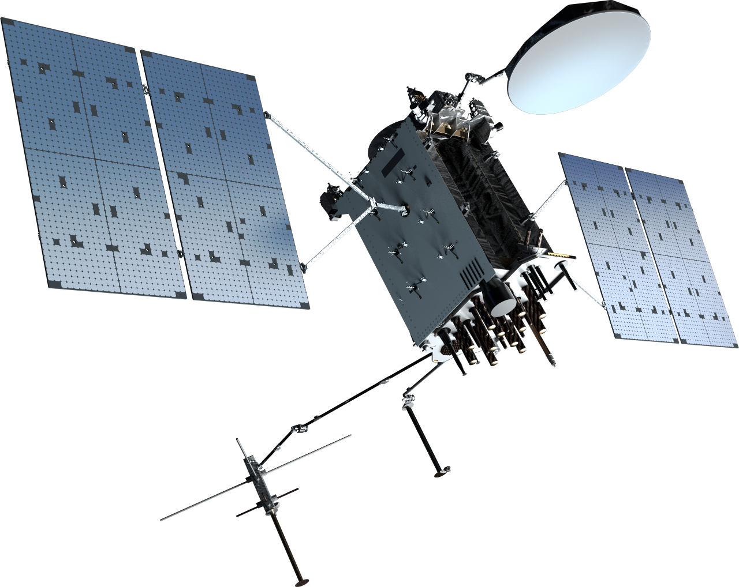
What satellite is this?
Notes:
GPS IIIF
https://www.lockheedmartin.com/en-us/products/gps.html
GPS signals as received at the Earth’s surface have an SNR (in the conventional sense) far below 1.
Here’s why:
1. Received GPS Signal Power
GPS satellites transmit around 25–50 W in the L-band (~1.5 GHz).
By the time the signal reaches Earth, it has spread over ~20,000 km and the received power is only about −160 dBW to −130 dBW (that’s roughly 10⁻¹⁶ W!).
2. Thermal Noise Floor
Thermal noise density at room temperature:
$$N_{0}=kT≈−174 \text{dBm}\text{/}\text{Hz}$$
In a typical GPS receiver:
With ~2 MHz bandwidth (C/A code), total noise power is about −111 dBm.
GPS signal power is around −160 dBW = −130 dBm.
So the signal is ~20 dB weaker than the noise in the raw RF channel.
3. How GPS Still Works
Even though the signal is “buried in noise”:
GPS uses spread spectrum CDMA (direct-sequence).
The satellite transmits a pseudorandom noise (PRN) code at 1.023 Mbps (C/A code).
The receiver generates the same PRN sequence locally and correlates it with the incoming signal.
This despreading process concentrates the signal energy while spreading the noise, effectively raising the post-correlation SNR to a usable level (>40 dB-Hz for tracking).
4. SNR Metrics in GPS
Raw RF: SNR << 1 (the signal is below noise).
After correlation: we talk about Carrier-to-Noise Density (C/N₀) in dB-Hz, typically 35–50 dB-Hz for a strong GPS signal.
Example: 45 dB-Hz means the effective SNR in a 1 Hz bandwidth is 45 dB.
✅ So in summary: GPS signals as received at Earth have an SNR far less than 1 (they’re below the noise floor). But correlation processing allows receivers to recover and track them reliably.

Slide 3
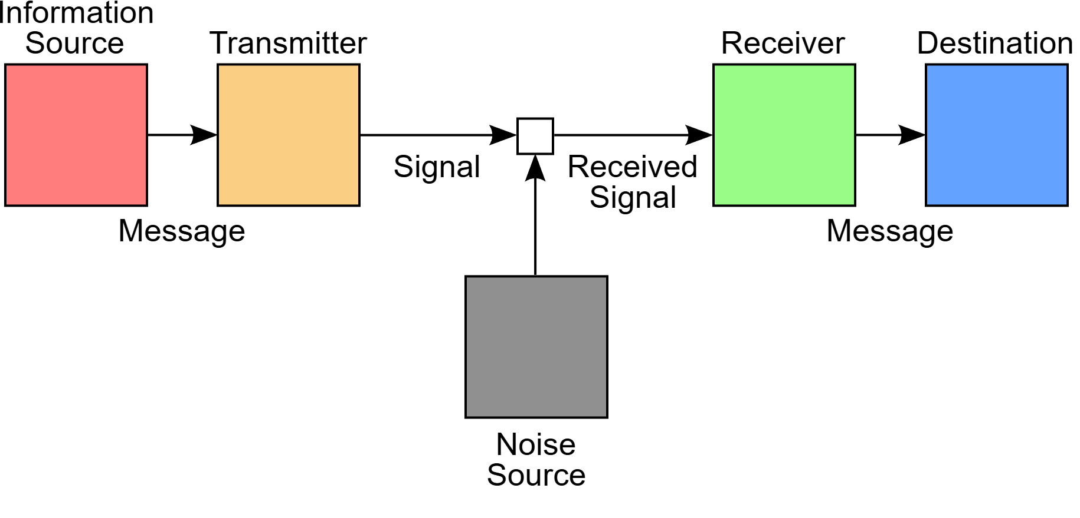
Satellite Communication (Satcom)
Shannon–Weaver model (1948): published in “Mathematical Theory of Communication” (1948) → One of the first models of communication
For spacecraft, the primary method of Telemetry, Tracking, and Command (TT&C) is RF communication.
RF Communication: method of transmitting data wirelessly using electromagnetic waves in the RF spectrum, typically between 3 kHz and 300 GHz
Optical (laser) Communication: An emerging alternative uses optical wavelengths of electromagnetic radiation to transmit messages wirelessly between user terminals
Notes:
https://www.nasa.gov/smallsat-institute/sst-soa/soa-communications/

Slide 4
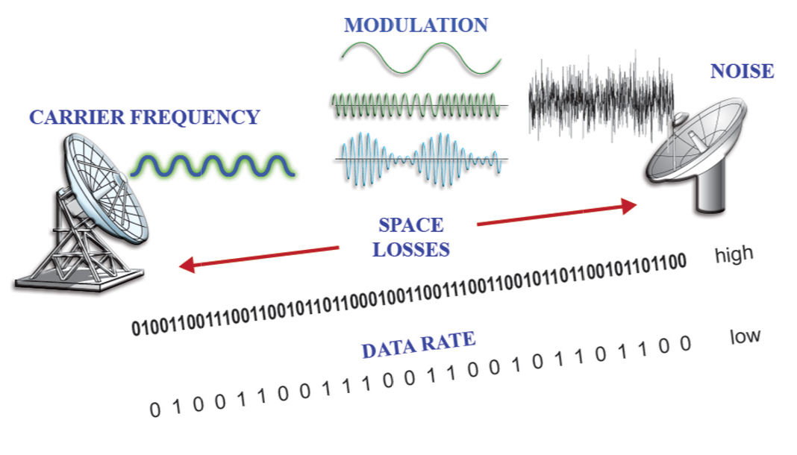
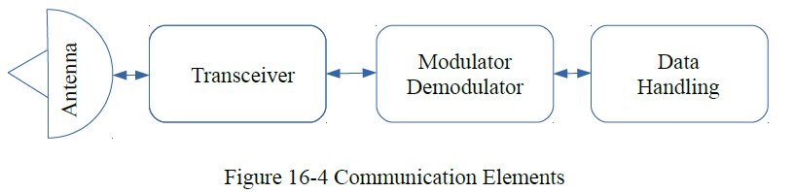
Satcom Parameters
(Understanding Space)
Notes:
Antenna – Transmits and receives signals, usually to and from a specific direction
Transceiver – A combination of a transmitter and receiver, it amplifies and broadcasts a signal or detects and amplifies a received signal
Modulator/Demodulator – Encodes data onto a carrier signal to be transmitted and extracts (decodes) data from a received signal

Slide 5
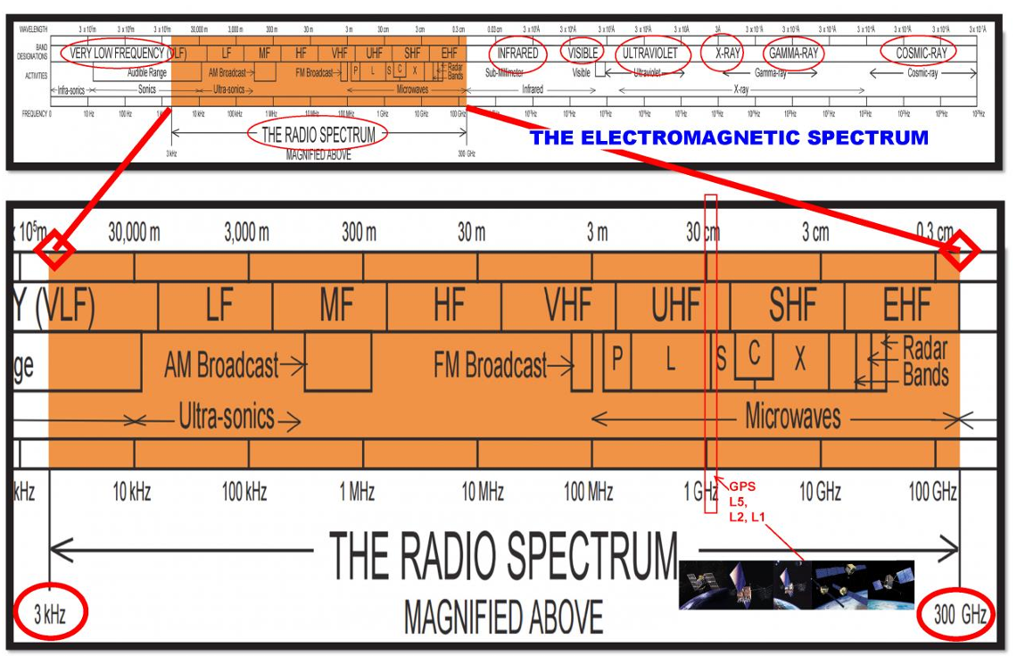
Electromagnetic Spectrum

Slide 6
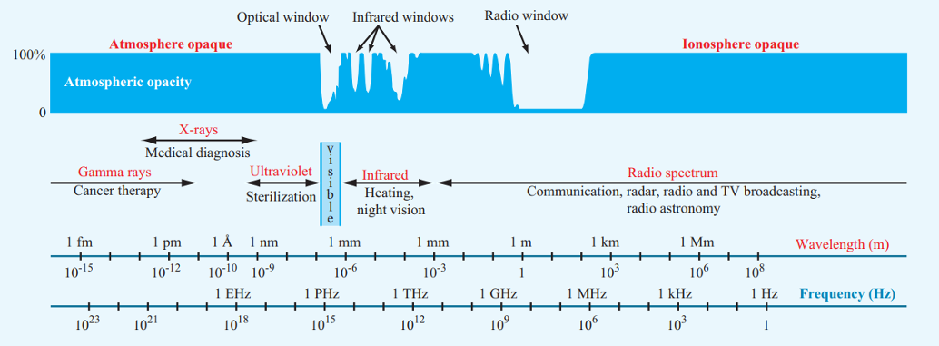
Atmospheric Windows

Slide 7
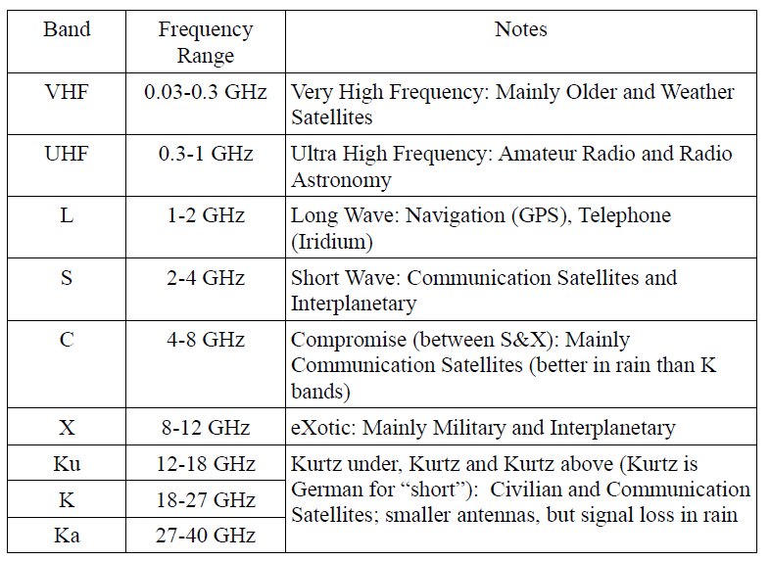
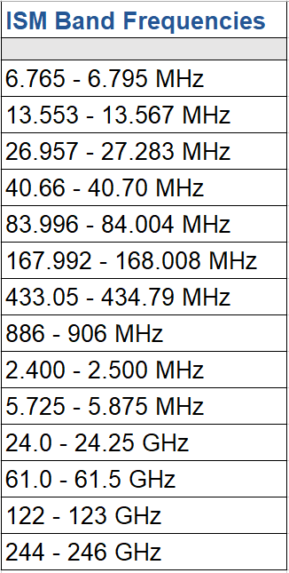
Radio Frequencies
Common RF:
WiFi: 2.4 / 5 Ghz (S/C band)
GPS L1: 1.575 Ghz (L Band)
Industrial, Scientific and Medical (ISM) Bands →
Notes:
Industrial, Scientific, and Medical (ISM) radio bands: These are special chunks of the radio spectrum set aside internationally for low-power, license-free use.

Slide 8
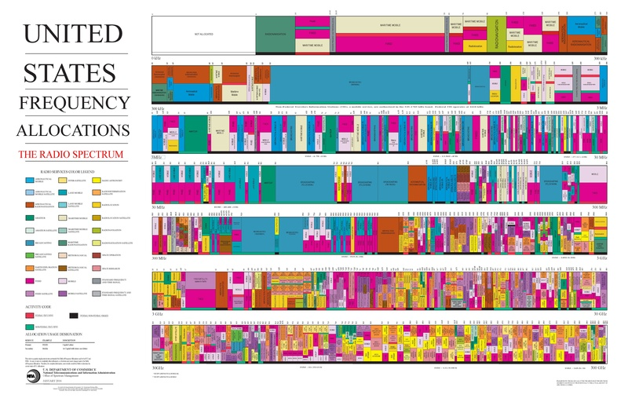
US RF Allocation
https://bookstore.gpo.gov/products/united-states-frequency-allocations-radio-spectrum-poster
Notes:
RF is congested!

Slide 9
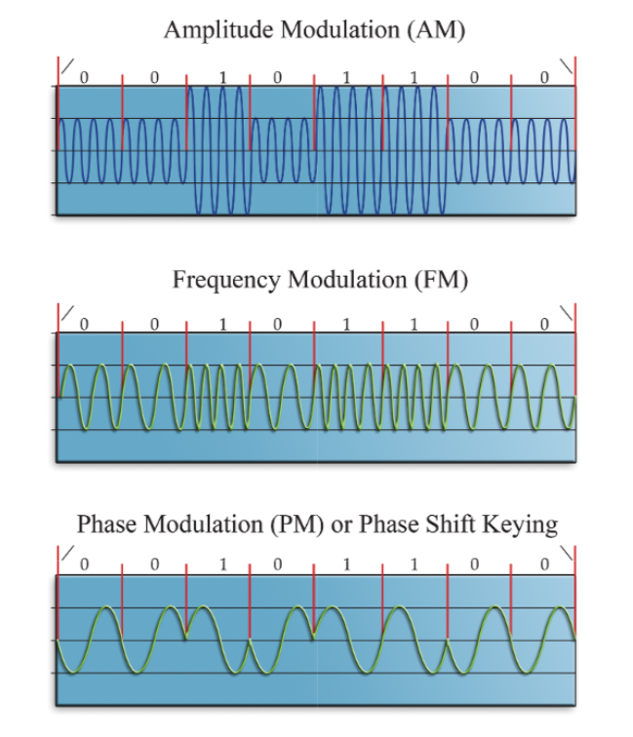
Modulation
Process of varying a carrier wave (usually sinusoidal) in amplitude, frequency, or phase to transmit information.
Amplitude Modulation (AM)
Vary the amplitude of the carrier proportional to the message signal.
Frequency Modulation (FM)
Vary the carrier frequency according to the signal.
Phase Shift Keying (PSK)
Change the phase of the carrier to represent digital data.
(Understanding Space)
Notes:
1. Amplitude Modulation (AM)
Principle: Vary the amplitude of the carrier proportional to the message signal.
Variants: Double-sideband (DSB), single-sideband (SSB).
Pros: Simple to implement, narrowband SSB saves power and spectrum.
Cons: Susceptible to noise and fading.
Space Use: Rare in modern spacecraft, but early missions used AM for analog telemetry.
2. Frequency Modulation (FM)
Principle: Vary the carrier frequency according to the signal.
Pros: Good noise immunity, robust for analog telemetry (voice, video).
Cons: Requires larger bandwidth than AM.
Space Use: Widely used in early space missions for voice and analog telemetry.
3. Phase Shift Keying (PSK)
Principle: Change the phase of the carrier to represent digital data.
Variants:
BPSK (Binary PSK): 0° or 180° → very robust, low spectral efficiency.
QPSK (Quadrature PSK): Four phase states (0°, 90°, 180°, 270°) → doubles bit rate.
8-PSK, 16-PSK: Higher data rates but more susceptible to noise.
Space Use: Common in telemetry links; BPSK/QPSK are NASA/ESA standards for deep space comms.
4. Quadrature Amplitude Modulation (QAM)
Principle: Combines both amplitude and phase modulation.
Variants: 16-QAM, 64-QAM, etc. (higher order = higher data rate).
Pros: Very spectrally efficient.
Cons: Sensitive to noise and non-linearities, requires high SNR.
Space Use: Emerging in high-rate downlinks (e.g., Ka-band Earth observation satellites).
5. Frequency Shift Keying (FSK)
Principle: Digital data transmitted by switching between discrete frequencies.
Variants: BFSK, MFSK.
Pros: Simple, robust to noise.
Cons: Less bandwidth efficient.
Space Use: Used in some low-data-rate beacon or CubeSat comm systems.
6. Spread Spectrum Techniques
DSSS (Direct Sequence Spread Spectrum)
FHSS (Frequency Hopping Spread Spectrum)
CDMA (Code Division Multiple Access)
Pros: Resistance to jamming, multipath, and interception.
Space Use: GPS uses DSSS/CDMA for navigation signals.
Spacecraft Applications
BPSK/QPSK: Standard for deep-space telemetry (Voyager, Mars missions).
QAM: Earth-observation satellites with high data downlinks.
FSK: CubeSat beacons.
Spread Spectrum (CDMA): GPS and GNSS systems.

Slide 10
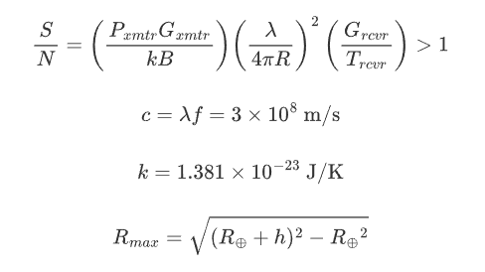
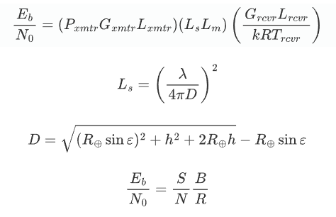
Link Budget
Link budget: An accounting of gains and losses in a communication system. Used to predicts the received signal quality at the ground station or spacecraft.
Link Margin: difference between the actual received signal power and the minimum required signal power for a reliable connection.
Astro 310: SNR
Astro 331/332: Eb/N0
SNR is a signal-to-noise power ratio, Eb/No normalizes SNR by data rate
Notes:
SNR tells you how loud the signal is. Eb/No tells you how efficiently you communicate.
Link Margin = What you have → extra “headroom” in your designed link.
Fade Margin = What you add → intentional safety buffer to handle fading events.
____________________________________________________________________________________
Communication can have a signal-to-noise ratio (SNR) of less than 1, and this is common in certain systems. An SNR of less than 1 simply means the power of the noise is greater than the power of the desired signal. While this makes communication challenging, it is not impossible due to advanced signal processing techniques.
When a ratio is expressed in decibels (dB), an SNR of less than 1 corresponds to a negative dB value. For example, an SNR of 0.01 is equivalent to -20 dB.
How communication is possible with low SNR
Several sophisticated methods allow for reliable data extraction even when the signal is "buried in the noise".
Spread spectrum communication
This technique, used in technologies like GPS and CDMA cellular networks, spreads the signal over a much wider bandwidth than necessary. The receiver, knowing the spreading code, can "de-spread" the signal, recovering the original data while the broadband noise is averaged out.
GPS: Satellite navigation signals are a well-known example of communication that operates with an extremely low SNR, often around -26 dB.
Coding gain
Forward Error Correction (FEC) codes add redundancy to the data stream. By encoding the information in a redundant way, the receiver can:
Use the redundant bits to detect and correct errors caused by the noise.
Combine multiple noisy signal samples to "integrate" the weak signal out of the noise. The noise, being random, tends to average out, while the repeating signal reinforces itself.
Processing gain
Used in spread spectrum systems, processing gain is the benefit achieved by spreading the signal. It allows the receiver to effectively integrate the low-power signal over time, boosting its relative power compared to the noise within the target bandwidth.
Analogy
Imagine trying to hear a person's voice (the signal) in a crowded, noisy room (the noise).
High SNR: The person is shouting directly in your ear, and the room is quiet. It is easy to hear them.
Low SNR (less than 1): The person is whispering, and everyone else is also shouting. Hearing the whisper is impossible without help.
Solution (with coding and processing gain): You record the sound with multiple high-quality microphones at once. By running the recording through special software, you can filter out the random shouting and amplify the repeating, structured whisper, allowing you to "hear" the message despite the dominant noise.
Consequences of low SNR
Even with advanced techniques, operating at a low SNR has trade-offs:
Lower data rates: To maintain reliability, the system must transmit data slower.
Higher power or bandwidth: To overcome low SNR, the system may need to use more power or spread the signal over a wider bandwidth.
Increased complexity: The signal processing equipment at the receiver becomes much more complex and expensive.

Slide 11
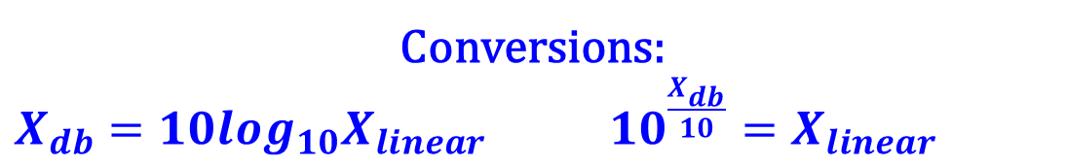
Decibels
Logarithms:
Turn multiplication into addition
Turn division into subtraction
Map enormous ranges onto a smaller space
Decibels (dB):
Logarithmic unit expressing ratio between two values of power.
In linear terms, multiplying by 1 causes no change → decibel equivalent is adding 0.
Adding 3 dB doubles signal strength.
Subtract 3 dB halves signal strength.
dBm: decibels relative to 1 mW
dBW: decibels relative to 1 W
Conversions:
$X_{db}=10\log_{10}X_{linear}$ $10^{\frac{X_{db}}{10}}=X_{linear}$

Slide 12

Eb/N0 (linear units)
$E_{b}/N_{0}$ is the “SNR” used in digital satcom
$$\frac{E_{b}}{N_{0}}=\frac{PL_{l}G_{t}L_{s}L_{m}G_{r}}{kT_{s}R}$$
$\frac{E_{b}}{N_{0}}$ = ratio of received energy-per-bit to noise-density
P = transmitted power (W)
$L_{l}$ = transmitter to antenna line loss (unitless < 1)
G_{t} = transmitter antenna gain (unitless)
L_{s} = free space path loss (unitless < 1)
L_{m} = miscellaneous loss (unitless < 1)
G_{r} = receiver antenna gain (unitless)
k = Boltzmann’s constant (1.38 * 10⁻²³ J/K)
T_{s} = temperature of receiver system (K)
R = data rate (bits per second)

Slide 13

Eb/No (Decibels)
In decibels: $X_{db}=10\log_{10}X_{linear}$
$${\frac{E_{b}}{N_{0}}}_{dB}=P+L_{l}+G_{t}+L_{s}+L_{m}+G_{r}+228.6−10\log{T_{s}}−10\log{R} \left(dB\right)$$
$\frac{E_{b}}{N_{0}}$ = ratio of received energy-per-bit to noise-density (db)
P = transmitted power (dBW)
$L_{l}$ = antenna line losses for transmitter and receiver (dB < 0)
G_{t} = transmitter antenna gain (dB)
L_{s} = free space path loss (dB < 0)
L_{m} = miscellaneous loss (dB < 0)
G_{r} = receiver antenna gain (dB)
T_{s} = temperature of receiver system (K)
R = data rate (bits per second)
Notes:
📘 Typical Eb/N₀ Ranges
BPSK / QPSK (uncoded):
Minimum ≈ 9–10 dB for a BER of ${10}^{−6}$.
With error-correcting codes, can operate as low as ~4–6 dB.
8-PSK / 16-PSK (higher-order PSK):
Require more Eb/N₀: ~12–15 dB for BER ${10}^{−6}$.
QAM (16-QAM, 64-QAM, etc.):
Very spectrally efficient, but BER performance is worse.
16-QAM: ~12 dB for BER ${10}^{−6}$.
64-QAM: ~18 dB for BER ${10}^{−6}$.
With Modern Coding (Turbo, LDPC, Reed-Solomon):
Can push reliable operation down to 0–3 dB Eb/N₀, depending on scheme and BER target.
Deep-space missions often operate at surprisingly low SNRs, relying on coding gain.
🚀 Spacecraft Standards
CubeSat UHF/S-band links: Aim for 6–10 dB Eb/N₀ for robust operation with simple coding.
Deep Space Network (DSN): Often targets 0–3 dB Eb/N₀ with heavy error correction, since received power is extremely weak (e.g., Voyager at –160 dBm).
Earth observation downlinks (X/Ka-band): Typically require >10 dB Eb/N₀ for high-rate, high-order modulation schemes.

Slide 14
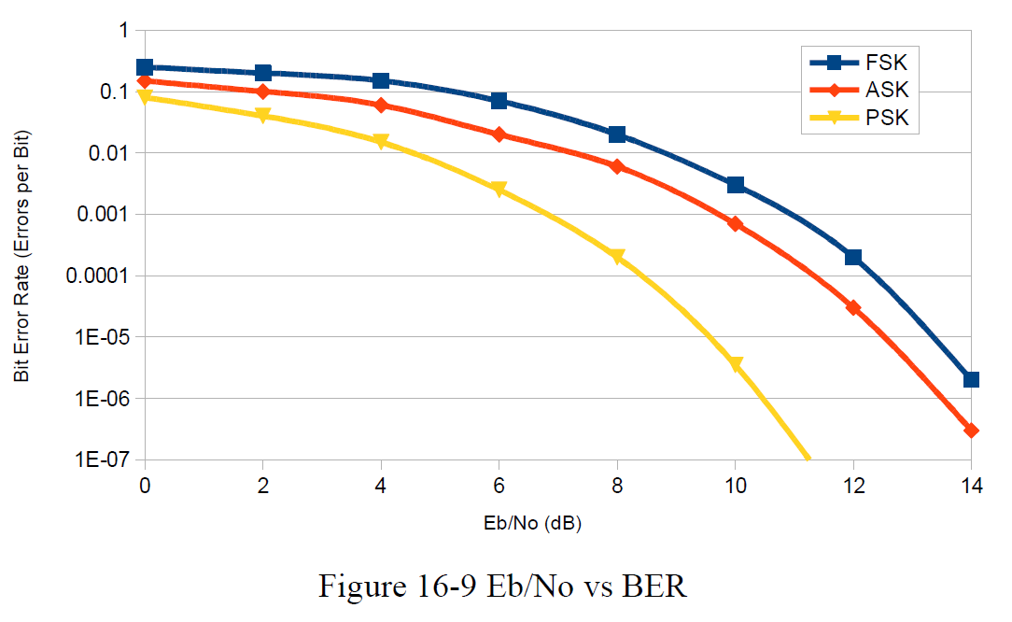

Bit Error Rate
Q: How do we know if a given Eb/N0 is good?
A: Choose an acceptable Bit Error Rate!
Bit error rate (BER): a performance metric that measures the number of bit errors that occur during data transmission, expressed as the ratio of incorrect bits to the total number of transferred bits.
→ BER = how reliable a digital communication signal is.
Notes:
The quality of a communication channel is affected by several factors that can corrupt data and increase the BER:
Noise and interference: Unwanted signals can alter the voltage levels of bits, causing the receiver to interpret a "0" as a "1" or vice versa.
Signal strength: A stronger signal relative to the background noise (a higher signal-to-noise ratio, or SNR) results in a lower BER. The closer a signal is to the noise floor, the less stable it becomes.
Modulation and coding: More robust modulation schemes sacrifice data rate for better error performance. Channel coding, such as Forward Error Correction (FEC), adds redundancy to the data stream to help detect and correct errors without retransmission.
Synchronization issues: If the receiver's clock is not perfectly synchronized with the transmitter, it may sample the incoming bits at the wrong moment, leading to errors.

Slide 15
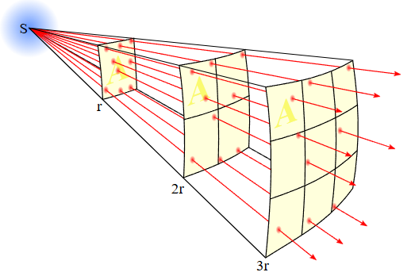
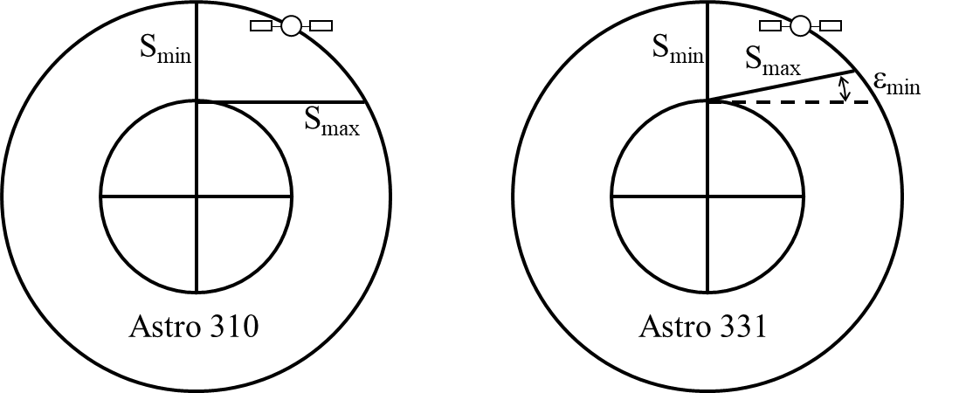

Free Space Path Loss, L_{s}
Weakening of a radio signal as it travels through space, caused by the spreading out of electromagnetic waves
$L_{s}={\left(\frac{λ}{4πS}\right)}^{2}$ (unitless)
$λ$ = signal wavelength (m)
S = signal path distance (range between tx & rx)
(careful of units: m vs km)
$$S_{max}= \sqrt{{\left(R_{⨁}\sin{ε_{min}}\right)}^{2}+h^{2}+2R_{⨁}h}−R_{⨁}\sin{ε_{min}}$$
Linear units!
Notes:
Assumes an ideal case: vacuum propagation, no obstacles, no absorption, no scattering — only geometric spreading.

Slide 16
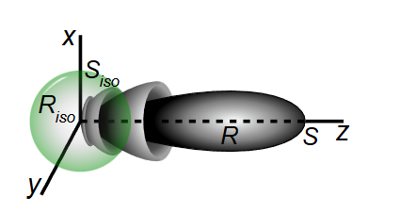
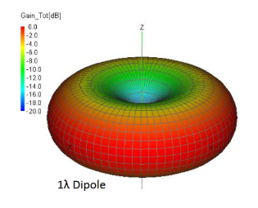
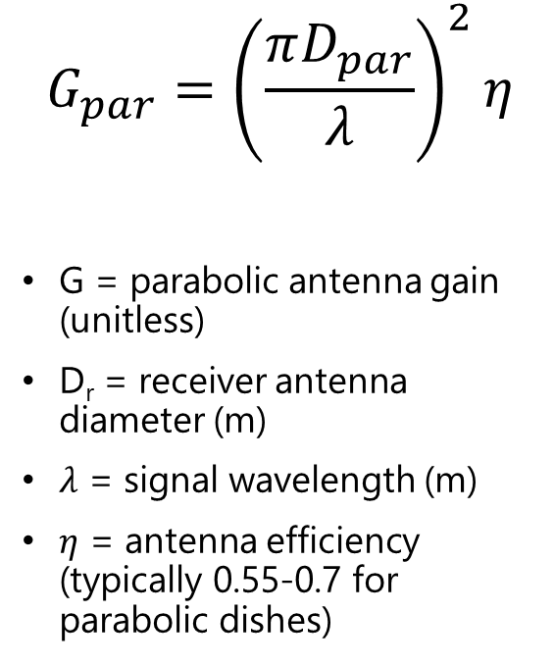
Antenna Gain
A measure of how effectively an antenna focuses radio energy in a particular direction compared to a theoretical isotropic antenna.
Isotropic: having the same property in all directions (ie, transmitting in all directions with same power level)
For parabolic antenna:
$$G_{par}={\left(\frac{πD_{par}}{λ}\right)}^{2}η$$
G = parabolic antenna gain (unitless)
D_{r} = receiver antenna diameter (m)
$λ$ = signal wavelength (m)
$η$ = antenna efficiency (typically 0.55-0.7 for parabolic dishes)
Linear units!
Notes:
dBi (decibels over isotropic): Compared to a theoretical isotropic antenna that radiates equally in all directions.

Slide 17
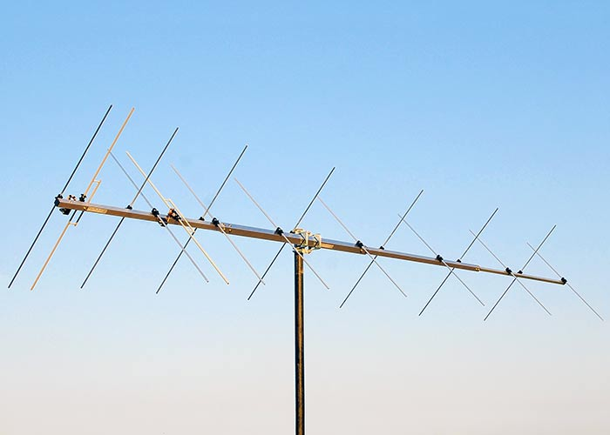
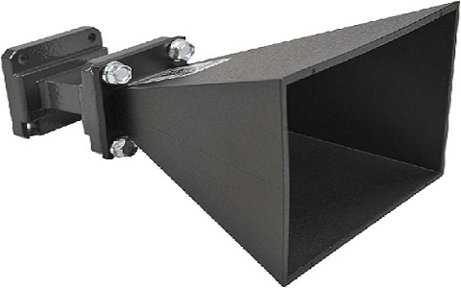
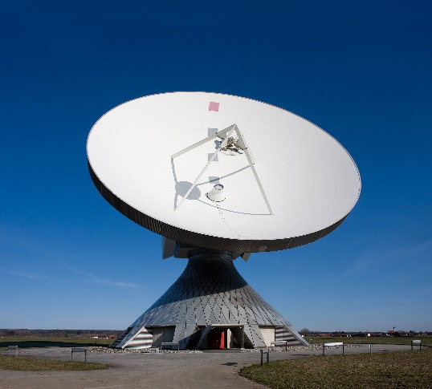
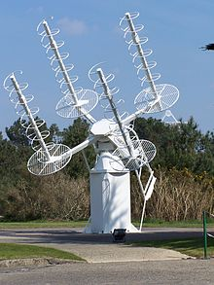
Common Antennas for SATCOM
Yagi
Horn
Parabolic
Phase Array
Helical

Slide 18
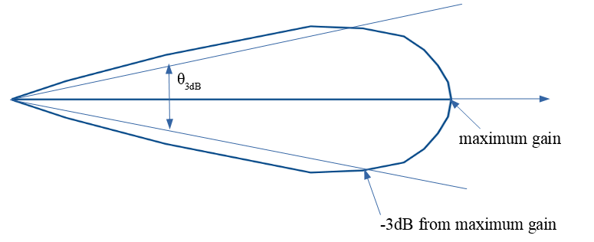
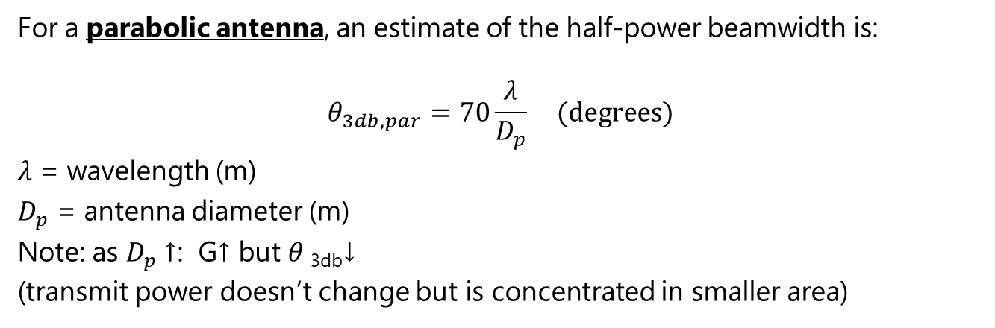
Antenna Beamwidth
For a parabolic antenna, an estimate of the half-power beamwidth is:
$$θ_{3db, par}=70\frac{λ}{D_{p}} (degrees)$$
$λ$ = wavelength (m)
$D_{p}$ = antenna diameter (m)
Note: as $D_{p}$↑: G↑ but $θ$_{3db}↓
(transmit power doesn’t change but is concentrated in smaller area)

Slide 19
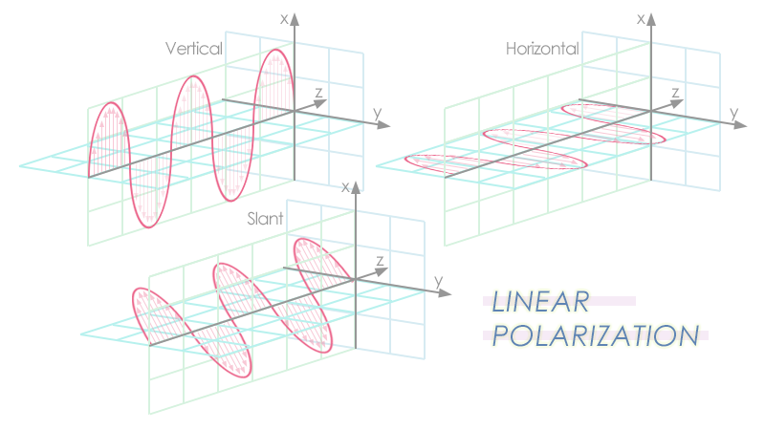
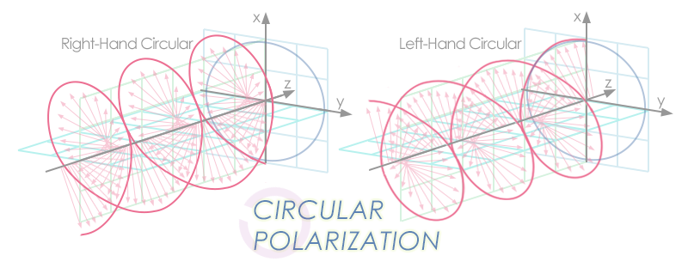
Antenna Polarization
Antenna polarization describes the orientation of the electric field vector of the radiated electromagnetic wave.
It must match between transmitting and receiving antennas for maximum signal transfer.
If TX and RX polarizations mismatch, significant signal loss occurs.
Notes:
Linear Polarization
Electric field stays in a straight line (horizontal or vertical).
Simple to implement, but polarization mismatch (e.g., horizontal TX vs vertical RX) can cause up to 20–30 dB loss.
Common in ground stations and many CubeSat links.
Circular Polarization
Electric field rotates in a circle as the wave propagates.
Two senses: Right-Hand Circular Polarization (RHCP) and Left-Hand Circular Polarization (LHCP).
Advantage: Less sensitive to rotation/misalignment between antennas.
Common in satellite comms, GPS uses RHCP.
Elliptical Polarization
General case between linear and circular.
Often a result of imperfect antenna design or propagation effects.
Spacecraft Applications
CubeSats in LEO: Often use circularly polarized ground antennas to avoid polarization loss as the satellite tumbles.
Deep Space Missions: High-gain antennas usually linearly polarized, but require careful alignment.
GPS: Uses RHCP to distinguish direct signals from reflected multipath signals (reflections flip polarization).

Slide 20
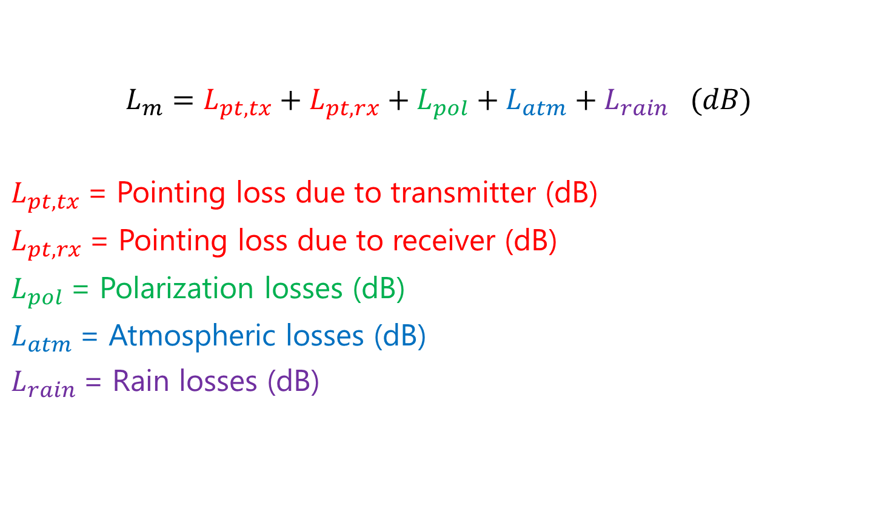
Miscellaneous Losses, L_{m}
$$L_{m}=L_{pt,tx}+L_{pt,rx}+L_{pol}+L_{atm}+L_{rain} (dB)$$
$L_{pt,tx}$= Pointing loss due to transmitter (dB)
$L_{pt,rx}$= Pointing loss due to receiver (dB)
$L_{pol}$= Polarization losses (dB)
$L_{atm}$= Atmospheric losses (dB)
$L_{rain}$= Rain losses (dB)

Slide 21
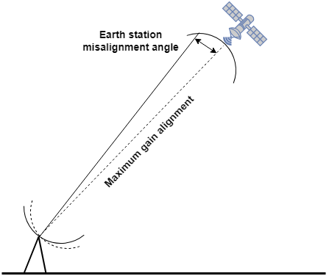
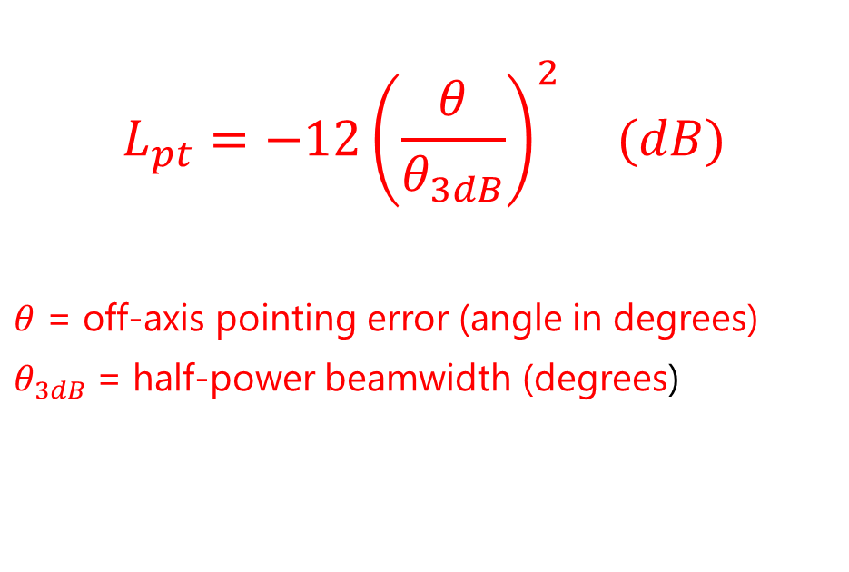
Antenna Pointing Loss, L_{pt}
Reduction in received signal strength caused when the transmitting or receiving antenna is not perfectly aligned with its target.
$$L_{pt}=−12{\left(\frac{θ}{θ_{3dB}}\right)}^{2} (dB)$$
$θ$ = off-axis pointing error (angle in degrees)
$θ_{3dB}$= half-power beamwidth (degrees)

Slide 22
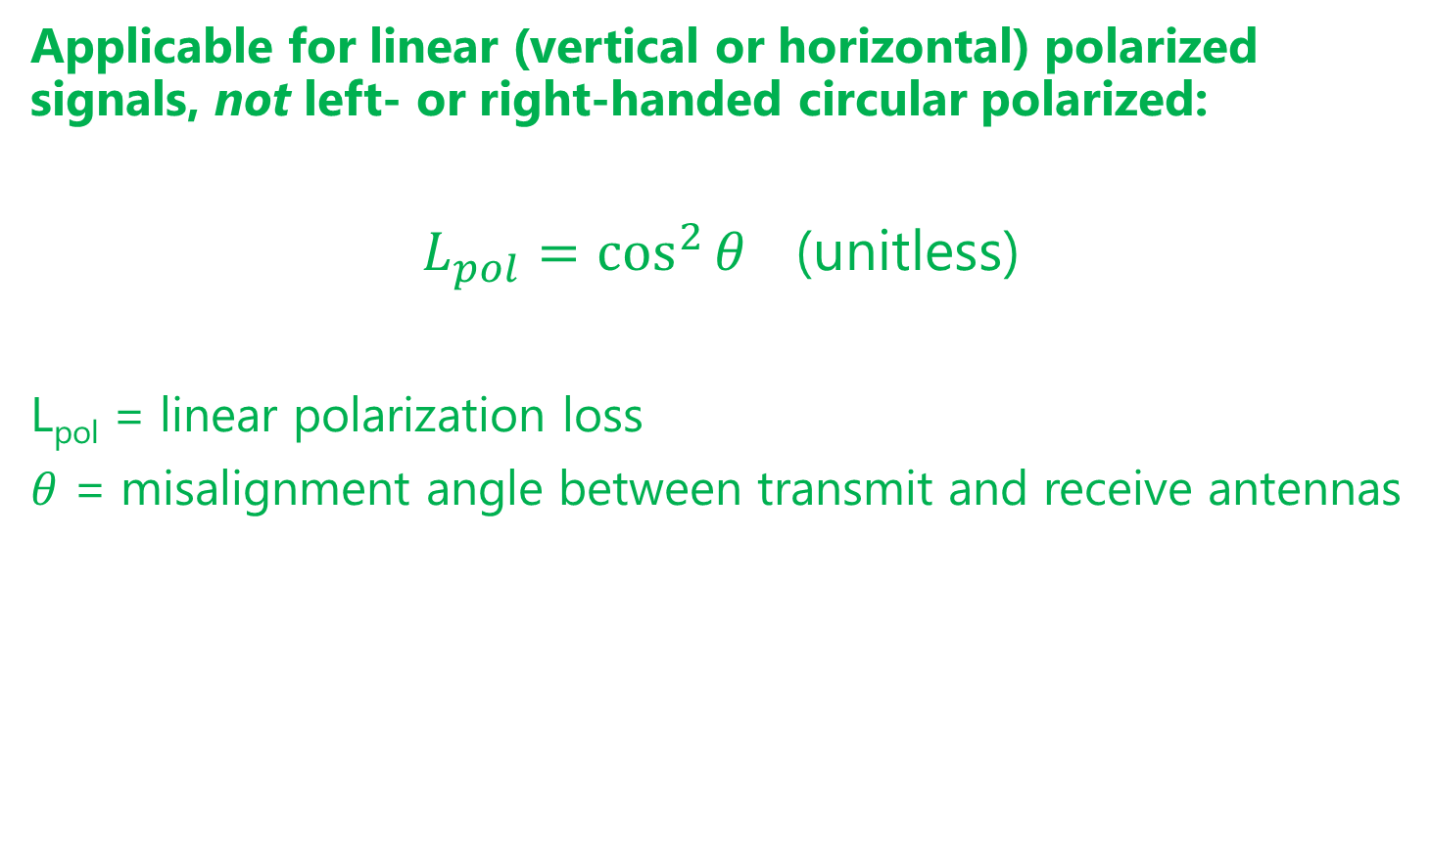
Polarization Mismatch Loss, L_{pol}
Applicable for linear (vertical or horizontal) polarized signals, not left- or right-handed circular polarized:
$L_{pol}=\cos^{2}{θ}$ (unitless)
L_{pol} = linear polarization loss
$θ$ = misalignment angle between transmit and receive antennas
Linear units!

Slide 23
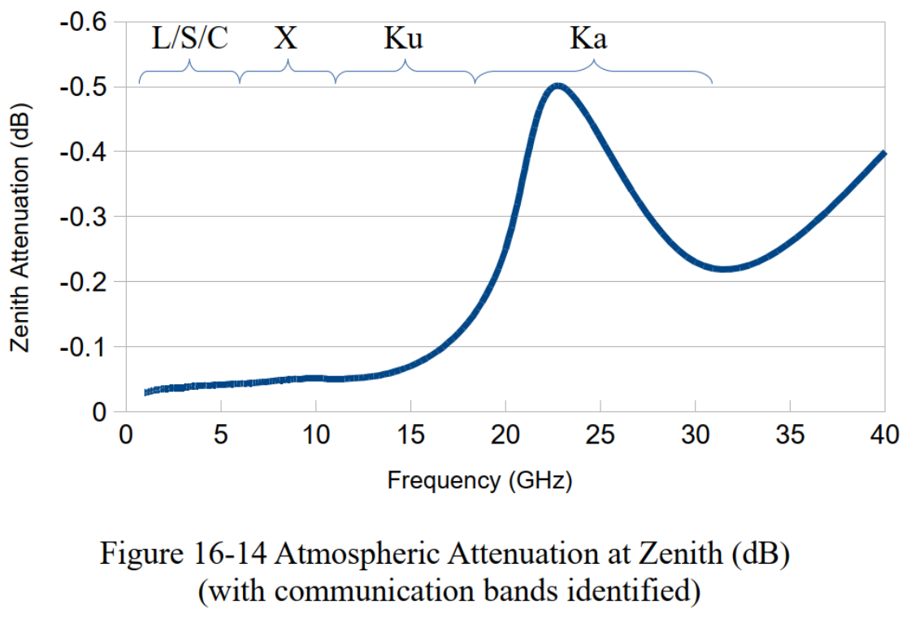
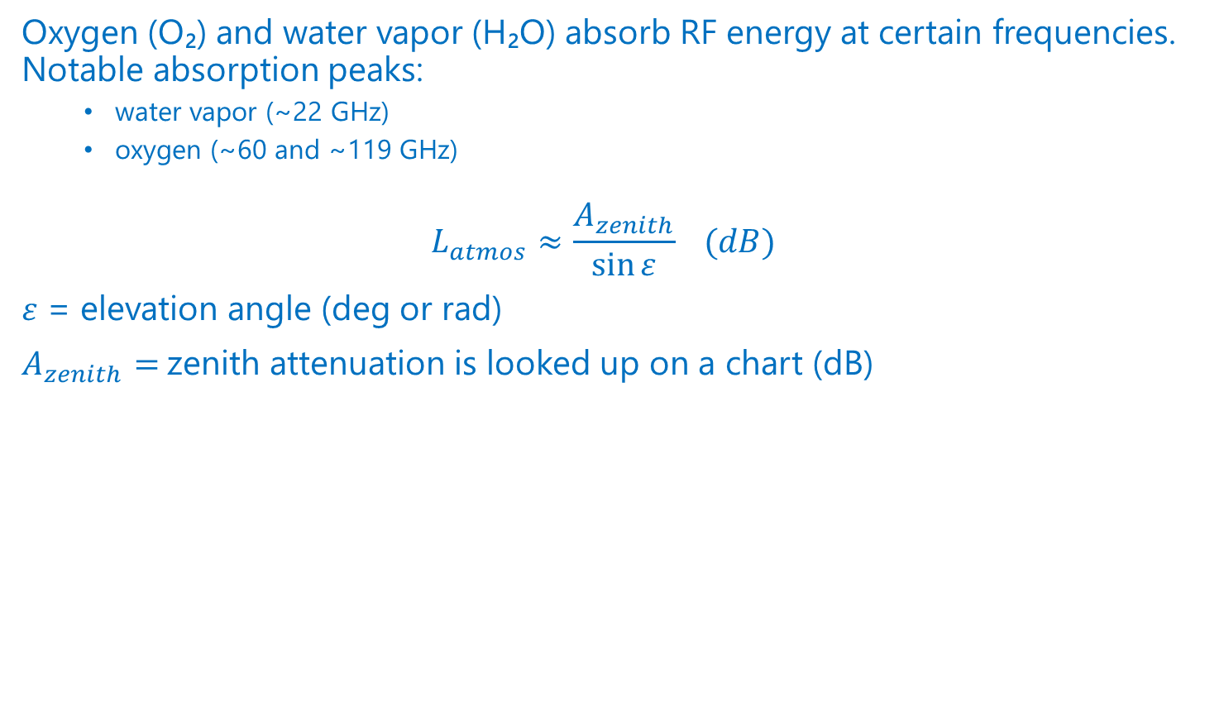
Atmospherics Losses, L_{atm}
Oxygen (O₂) and water vapor (H₂O) absorb RF energy at certain frequencies. Notable absorption peaks:
water vapor (~22 GHz)
oxygen (~60 and ~119 GHz)
$$L_{atmos}≈\frac{A_{zenith}}{\sin{ε}} (dB)$$
$ε$ = elevation angle (deg or rad)
$A_{zenith}=$zenith attenuation is looked up on a chart (dB)

Slide 24
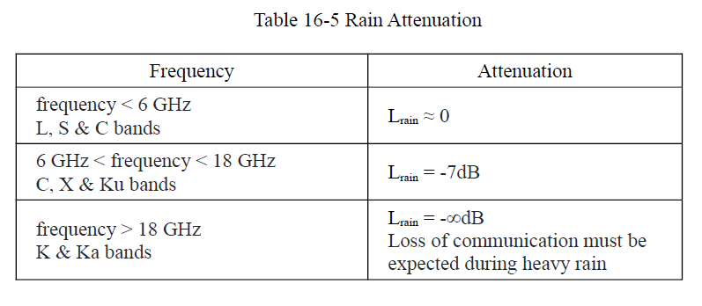
Rain Losses
Attenuation of radio signals caused by absorption and scattering of electromagnetic waves as they pass through raindrops in the atmosphere.
Notes:
Factors Influencing Rain Losses
Rain rate (mm/hr): Heavier rainfall → higher attenuation.
Frequency: Higher frequency → more affected.
Path length through rain: Longer slant paths (low elevation angles) increase losses.
Raindrop size distribution: Larger drops scatter more strongly.
Mitigation Techniques
Fade Margin: Extra link budget power to handle expected rain losses.
Diversity: Multiple ground stations in different climates to ensure coverage.
Adaptive Coding & Modulation (ACM): Reduce data rate temporarily during fades to maintain link.
Site Selection: Locate ground stations in arid regions (e.g., NASA’s DSN sites in Goldstone, Madrid, Canberra).

Slide 25
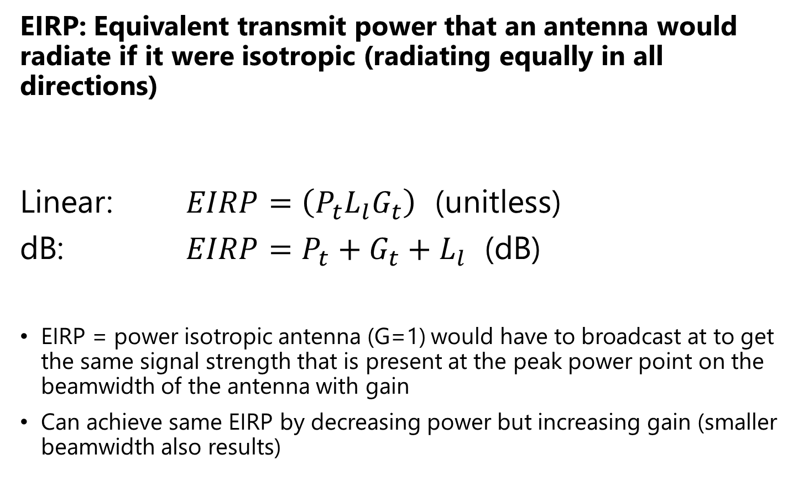
Effective Isotropic Radiated Power (EIRP)
EIRP: Equivalent transmit power that an antenna would radiate if it were isotropic (radiating equally in all directions)
Linear: $EIRP=\left(P_{t}L_{l}G_{t}\right)$ (unitless)
dB: $EIRP=P_{t}+G_{t}+L_{l}$ (dB)
EIRP = power isotropic antenna (G=1) would have to broadcast at to get the same signal strength that is present at the peak power point on the beamwidth of the antenna with gain
Can achieve same EIRP by decreasing power but increasing gain (smaller beamwidth also results)

Slide 26
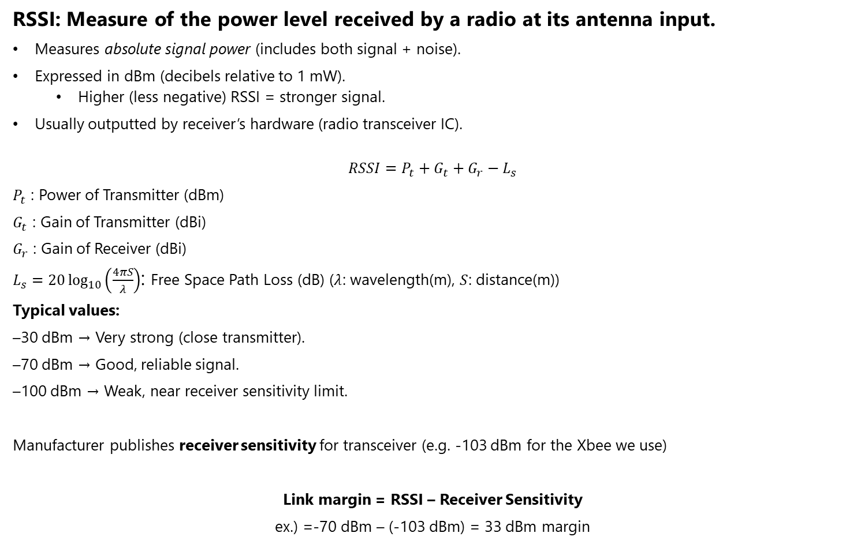
Received Signal Strength Indicator (RSSI)
RSSI: Measure of the power level received by a radio at its antenna input.
Measures absolute signal power (includes both signal + noise).
Expressed in dBm (decibels relative to 1 mW).
Higher (less negative) RSSI = stronger signal.
Usually outputted by receiver’s hardware (radio transceiver IC).
$$RSSI=P_{t}+G_{t}+G_{r}−L_{s}$$
$P_{t}$ : Power of Transmitter (dBm)
$G_{t}$ : Gain of Transmitter (dBi)
$G_{r}$ : Gain of Receiver (dBi)
$L_{s}=20\log_{10}\left(\frac{4πS}{λ}\right)$: Free Space Path Loss (dB) ($λ$: wavelength(m), $S$: distance(m))
Typical values:
–30 dBm → Very strong (close transmitter).
–70 dBm → Good, reliable signal.
–100 dBm → Weak, near receiver sensitivity limit.
Manufacturer publishes receiver sensitivity for transceiver (e.g. -103 dBm for the Xbee we use)
Link margin = RSSI – Receiver Sensitivity
ex.) =-70 dBm – (-103 dBm) = 33 dBm margin

Slide 27
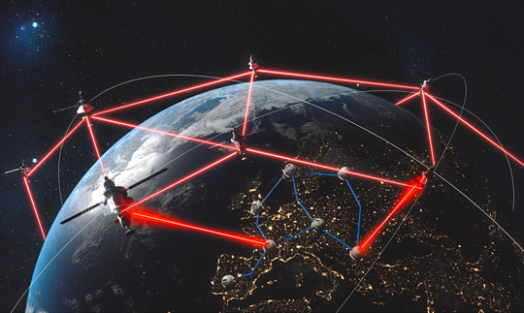
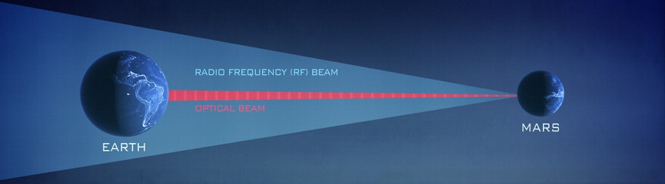
Free Space Optical Communications (FSO)
AKA laser communication: uses infrared or visible laser beams instead of RF waves.
Advantages:
Much higher data rates (Gbps possible).
Narrow beams → less interference, more secure.
Smaller terminals compared to high-gain RF antennas.
Challenges:
Requires extremely precise pointing and tracking.
Sensitive to cloud cover and atmospheric distortion (needs ground stations with clear skies).
Notes:
Examples:
https://spacenews.com/spacex-satellites-with-tesat-terminals-achieve-first-laser-data-exchange-for-u-s-military/
NASA’s Lunar Laser Communication Demonstration (LLCD, 2013).
ESA’s EDRS (European Data Relay System) optical links.
NASA’s Psyche mission is carrying a deep-space laser comm experiment (DSOC).

Slide 28
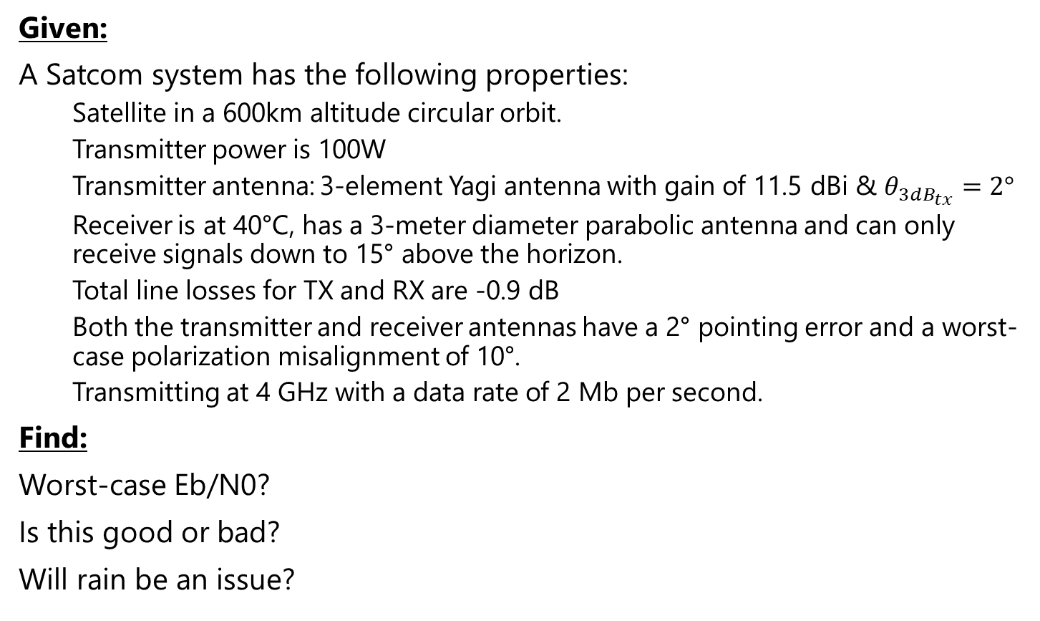
Satcom Example
Given:
A Satcom system has the following properties:
Satellite in a 600km altitude circular orbit.
Transmitter power is 100W
Transmitter antenna: 3-element Yagi antenna with gain of 11.5 dBi & $θ_{3dB_{tx}}=2°$
Receiver is at 40°C, has a 3-meter diameter parabolic antenna and can only receive signals down to 15° above the horizon.
Total line losses for TX and RX are -0.9 dB
Both the transmitter and receiver antennas have a 2° pointing error and a worst-case polarization misalignment of 10°.
Transmitting at 4 GHz with a data rate of 2 Mb per second.
Find:
Worst-case Eb/N0?
Is this good or bad?
Will rain be an issue?

Slide 29


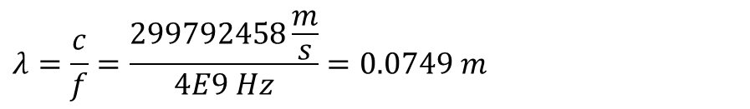
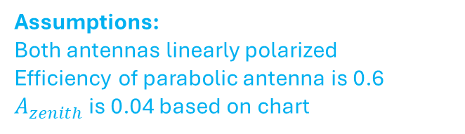
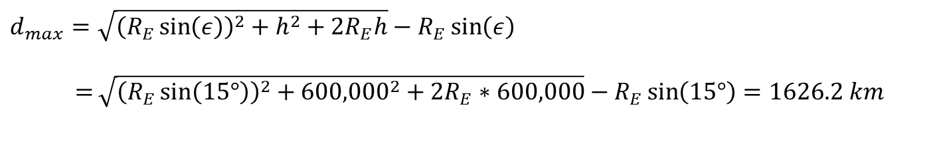
Satcom Example – Solution Part 1
$$\frac{E_{b}}{N_{0}}=P_{t}+G_{t}+L_{l}+L_{s}+L_{m}+G_{r}+228.6−10\log_{10}{T_{r}}−10\log_{10}{R}$$
Assumptions:
Both antennas linearly polarized
Efficiency of parabolic antenna is 0.6
$A_{zenith}$ is 0.04 based on chart
$P_{t}=10 W=10 dBW$
$$G_{t}=11.5 dBi$$
$$L_{l}=−0.9 dB$$
$$λ=\frac{c}{f}=\frac{299792458\frac{m}{s}}{4E9 Hz}=0.0749 m$$
$$R_{E}=6,378,137 m$$
$$d_{max}=\sqrt{{\left(R_{E}\sin\left(ε\right)\right)}^{2}+h^{2}+2R_{E}h}−R_{E}\sin\left(ε\right)$$
$=$ $\sqrt{{\left(R_{E}\sin\left(15°\right)\right)}^{2}+{600,000}^{2}+{2R}_{E}∗600,000}−R_{E}\sin\left(15°\right)=1626.2 km$
$$L_{s}={\left(\frac{λ}{4πd_{max}}\right)}^{2}=1.795E\text{−}10=10\log_{10}{1.795E\text{−}10=−168.7dB}$$

Slide 30
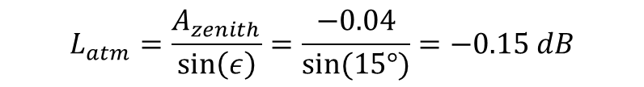
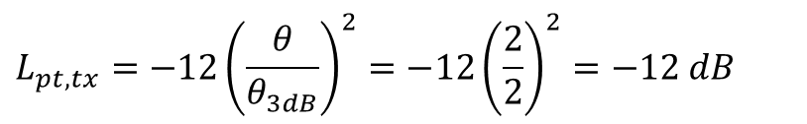
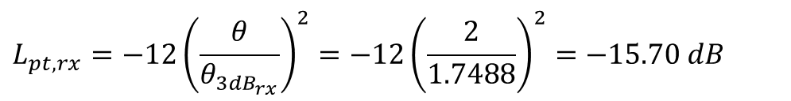
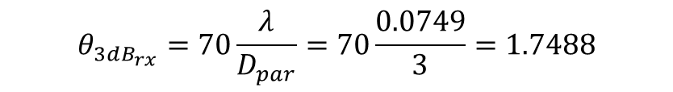
Satcom Example – Solution Part 2
$$\frac{E_{b}}{N_{0}}=P_{t}+G_{t}+L_{l}+L_{s}+L_{m}+G_{r}+228.6−10\log_{10}{T_{r}}−10\log_{10}{R}$$
$$L_{m}=L_{pt,tx}+L_{pt,rx}+L_{pol}+L_{atm}+L_{rain}$$
$$L_{pt,tx}=−12{\left(\frac{θ}{θ_{3dB}}\right)}^{2}=−12{\left(\frac{2}{2}\right)}^{2}=−12 dB$$
$$θ_{3dB_{rx}}=70\frac{λ}{D_{par}}=70\frac{0.0749}{3}=1.7488$$
$$L_{pt,rx}=−12{\left(\frac{θ}{θ_{3dB_{rx}}}\right)}^{2}=−12{\left(\frac{2}{1.7488}\right)}^{2}=−15.70 dB$$
$$L_{pol}=\cos^{2}\left(θ\right)=\cos^{2}\left(10°\right)=0.9698=10\log_{10}\left(0.9698\right)=−0.13 dB$$
$$L_{atm}=\frac{A_{zenith}}{\sin\left(ε\right)}=\frac{−0.04}{sin⁡(15°)}=−0.15 dB$$
$$L_{rain}=0 dB since f<6 GHz$$
$$L_{m}=−12−15.7−0.13−0.15−0=−27.98 dB$$

Slide 31


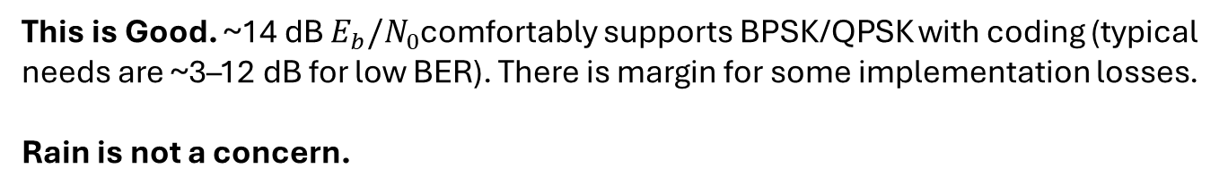
Satcom Example – Solution Part 3
$$\frac{E_{b}}{N_{0}}=P_{t}+G_{t}+L_{l}+L_{s}+L_{m}+G_{r}+228.6−10\log_{10}{T_{r}}−10\log_{10}{R}$$
$$T_{r}=40℃+273.15=313.15K$$
$$R=2E6 bps$$
$$G_{r}=G_{par}={\left(\frac{πD_{par}}{λ}\right)}^{2}η={\left(\frac{π\left(3\right)}{0.0749}\right)}^{2}\left(0.6\right)=9.48E3=10\log_{10}{9.48E3}=39.77 dB$$
$$\frac{E_{b}}{N_{0}}=10+11.5−0.9−168.7−27.98+39.77+228.6−10\log_{10}{(313.15)}−10\log_{10}{(2E6)}$$
$$=14.3085 dB$$
This is Good. ~14 dB $E_{b}/N_{0}$comfortably supports BPSK/QPSK with coding (typical needs are ~3–12 dB for low BER). There is margin for some implementation losses.
Rain is not a concern.

Slide 32
Extra Topics

Slide 33
Shannon Limit
Notes:
The Shannon limit (sometimes called the Shannon capacity limit) is a fundamental concept from Claude Shannon’s information theory that tells us the maximum rate at which we can reliably transmit information over a communication channel in the presence of noise.
The Shannon–Hartley Theorem
For a channel with bandwidth $B$(in Hz) and a signal-to-noise ratio (SNR), the maximum achievable data rate (capacity) is:
$$C=B⋅{\log{}}_{2}\left(1+\frac{S}{N}\right) \text{bits} \text{per} \text{second}$$
Where:
$C$= channel capacity (bits/s)
$B$= channel bandwidth (Hz)
$S/N$= signal-to-noise ratio (linear, not in dB)
What It Means
If you try to transmit faster than $C$, errors will inevitably overwhelm you—no coding scheme can prevent it.
If you transmit at or below $C$, in theory, there exist clever coding methods that can get arbitrarily close to error-free communication.
This sets an absolute physical limit, dictated by noise and bandwidth.
Connection to Noise
Noise (thermal noise, interference, etc.) is what caps the information capacity.
With more bandwidth, you can pack more symbols per second.
With higher SNR, you can distinguish more reliably between symbols.
With low SNR, capacity shrinks—at very low SNR, the system becomes noise-limited.
Example
Suppose you have:
Bandwidth $B=1 \text{MHz}$
SNR = 10 (10:1 linear = 10 dB)
$$C=1×{10}^{6}⋅{\log{}}_{2}\left(1+10\right)≈3.46 \text{Mbps}$$
So no matter what modulation/coding you invent, you can’t exceed ~3.46 Mbps on that channel.
In short: The Shannon limit defines the maximum achievable information rate over a noisy channel, given its bandwidth and SNR. It’s the ultimate yardstick for communications performance—every real-world system is measured against it.
GPS is a perfect real-world example of the Shannon limit in action, because GPS signals are incredibly weak when they reach Earth, often below the noise floor. Let’s walk through it step by step.
1. GPS Signal at the Receiver
GPS satellites transmit around 20–30 W at L-band (e.g., 1575.42 MHz for L1).
By the time the signal arrives at Earth, it has spread over ~20,000 km of free-space path loss.
The received signal power is only about:
$$P_{rx}≈−160 \text{dBW}=−130 \text{dBm}$$
which is far weaker than thermal noise in the receiver.
2. Noise Power in GPS Bandwidth
Thermal noise density is:
$$N_{0}=−174 \text{dBm}\text{/}\text{Hz}$$
For GPS L1 C/A:
Bandwidth ≈ 2 MHz
$$N=N_{0}+10{\log{}}_{10}\left(B\right)=−174 + 10{\log{}}_{10}\left(2×{10}^{6}\right)$$
$$N≈−174+63=−111 \text{dBm}$$
So the signal-to-noise ratio in that bandwidth is:
$$SNR=−130−\left(−111\right)=−19 \text{dB}$$
That means the GPS signal is ~80× weaker than the noise power!
3. Shannon Capacity
The Shannon–Hartley theorem:
$$C=B⋅{\log{}}_{2}\left(1+S/N\right)$$
In linear terms:
$$S/N={10}^{\frac{−19}{10}}≈0.0126$$
Bandwidth $B=2×{10}^{6} \text{Hz}$
$$C=2×{10}^{6}⋅{\log{}}_{2}\left(1+0.0126\right)$$
$$C≈2×{10}^{6}⋅0.0181=36 \text{kbps}$$
So even though the GPS signal is below the noise floor, the Shannon limit still allows about 36 kbps of capacity in that channel.
4. Reality of GPS
The GPS C/A code data rate is only 50 bps (yes, just 50 bits per second).
That’s orders of magnitude below the Shannon capacity (36 kbps).
Why so low? Because GPS needs extremely robust reception with minimal errors, even in urban canyons or with cheap receivers.
GPS uses spread-spectrum (CDMA):
The C/A code spreads 50 bps data over a 1.023 MHz pseudorandom code.
This allows the receiver to use correlation processing gain to pull the signal out of the noise.
In effect, the system exploits Shannon’s limit by trading bandwidth for processing gain.
✅ Key Insight
Shannon says: even at –19 dB SNR, you can theoretically get ~36 kbps through the channel.
GPS designers chose 50 bps, giving a huge margin for robustness, synchronization, and global availability.
This is why your phone can lock onto GPS even though the signal looks like “noise” on a spectrum analyzer.

